Slide 1

School of Computer Science and Engineering
IILM University, Greater Noida, U.P.
Internship Topic/Title: TCS iON Career Edge – Young Professional
Student Name: ADARSH YADAV
Enrollment Number: 25SCS100302441
Program & Semester: B.Tech CSE – Semester III
Organization Name: TCS iON (Tata Consultancy Services)

Slide 2
IILM UNIVERSITY
TCS iON Career Edge – Young Professional
Training / Professional Development Program
INTERNSHIP PRESENTATION
Student Name
ADARSH YADAV
Roll Number
2441
Program & Semester
B.Tech CSE | Semester III
Batch
2025–29
Organization
TCS iON (Tata Consultancy Services)
Program Dates
11 August 2026 – 25 August 2026
TCS iON Career Edge – Young Professional | Adarsh Yadav
1

Slide 3
1. Program Overview
Introduction
What is the program?
Program Duration
TCS iON Career Edge – Young Professional is a professional-development
course designed around workplace readiness, communication, problem-solving and foundational technology awareness.
Completed from 11 August 2026 to 25 August 2026, with a certificate
issued upon successful completion.
Core Areas Covered
Communication Skills • Thinking Skills for Workplace Success • Presentation Skills • Soft Skills • Resume Writing • Group Discussion Skills
• Interview Skills • Business Etiquette • Effective Email Writing • Problem-Solving Mindset • Accounting Fundamentals • IT Foundational Skills • Overview of Artificial Intelligence
TCS iON Career Edge – Young Professional | Adarsh Yadav
2

Slide 4
2. Organization Profile
TCS iON
TCS iON
Industry Context
Program Relevance
TCS iON is a strategic business unit of Tata
Consultancy Services focused on technology-led solutions for education and skill development. Its platform supports learning, assessment and related institutional processes.
Education Technology Skill Development Digital Learning Assessment & Skilling
The Young Professional course connects
academic learning with workplace-oriented skills such as communication, interviews, professional etiquette and foundational IT awareness.
Why this organization mattered for the program
The program provided a structured setting to develop professional readiness alongside
technical education. It complements B.Tech CSE studies by strengthening communication, workplace thinking and awareness of current technology areas.
TCS iON Career Edge – Young Professional | Adarsh Yadav
3

Slide 5
3. Problem Statement / Training Need
Why the program
Technical education alone is not sufficient for effective workplace performance.
Students need communication and presentation skills to explain ideas clearly.
Resume, group discussion and interview skills are important for entering professional environments.
Professional etiquette and effective email writing support day-to-day workplace communication.
A problem-solving mindset helps students approach workplace situations more systematically.
Awareness of IT foundations and Artificial Intelligence helps connect professional skills with the technology domain.
Training focus: becoming more workplace-ready while building on a technical education.
TCS iON Career Edge – Young Professional | Adarsh Yadav
4

Slide 6
4. Program Objectives
Learning goals
Communicate effectively
Present ideas clearly
Prepare for recruitment
Build clear professional communication
and workplace interaction skills.
Strengthen presentation skills
and confidence in expressing information.
Develop resume, group discussion and
interview readiness.
Think professionally
Understand professional norms
Strengthen technology awareness
Build workplace-oriented thinking and
a problem-solving mindset.
Learn business etiquette and effective
email writing.
Gain IT foundational knowledge and
an overview of Artificial Intelligence.
TCS iON Career Edge – Young Professional | Adarsh Yadav
5

Slide 7
5. Scope of the Program
Coverage
Professional Skills
Career Readiness
Foundational Knowledge
• Communication Skills • Presentation Skills • Soft Skills • Business Etiquette • Effective Email Writing
• Resume Writing • Group Discussion Skills • Interview Skills • Thinking Skills for Workplace Success • Problem-Solving Mindset
• Accounting Fundamentals • IT Foundational Skills • Overview of Artificial Intelligence The scope is complementary to a B.Tech CSE
curriculum and focuses on professional readiness.
TCS iON Career Edge – Young Professional | Adarsh Yadav
6

Slide 8
6. Methodology & Learning Approach
How the program was structured
01
02
03
04
Learn
Understand
Develop
Apply
Course modules introduced profess
ional and foundational concepts.
Key workplace skills and
expectations were covered across multiple areas.
The program focused on building
communication, career-readiness and problem-solving capabilities.
The learning is intended to support
professional interactions, recruitment situations and workplace communication.
TCS iON Career Edge – Young Professional | Adarsh Yadav
7

Slide 9
7. Expected Outcomes / Learning Outcomes
Results
Communication
Presentation
Career Readiness
Improved awareness of clear and
professional communication.
Better understanding of how to
structure and deliver professional
presentations.
Greater familiarity with resumes,
group discussions and interviews.
Workplace Behaviour
Problem Solving
Technology Awareness
Awareness of etiquette, email practices
and professional expectations.
Stronger emphasis on approaching
workplace challenges with a
problem-solving mindset.
Broader exposure to IT foundations
and Artificial Intelligence.
Overall outcome: stronger professional preparedness alongside technical education.
TCS iON Career Edge – Young Professional | Adarsh Yadav
8

Slide 10
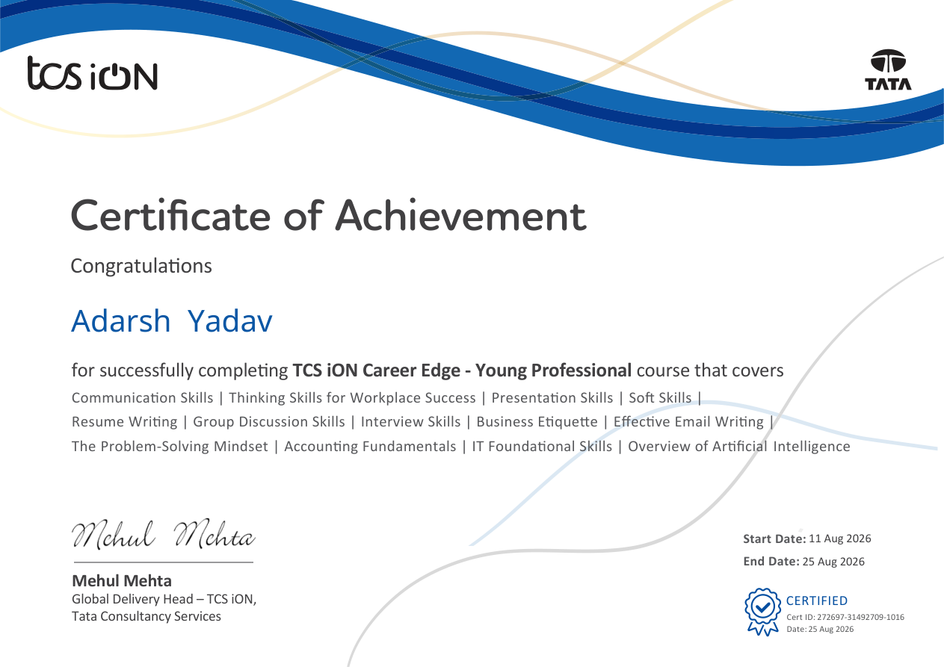
8. Internship / Training Completion Certificate
Evidence
Certificate Details
TCS iON Career Edge – Young Professional Completed: 25 August 2026
Covered Areas
Communication, thinking skills,
presentation, soft skills, resume writing, interviews, workplace etiquette, problem-solving, IT foundations and AI overview.
Certificate attached separately for verification.
TCS iON Career Edge – Young Professional | Adarsh Yadav
9

Slide 11
9. Conclusion
Reflection
Key Takeaway
How it supports my career
The TCS iON Career Edge – Young Professional program
complemented my B.Tech CSE education by focusing on the
professional skills required beyond technical knowledge. It strengthened my understanding of communication, presentation,
recruitment readiness, workplace etiquette, problem-solving and foundational technology awareness.
These skills can help me communicate technical ideas, prepare for
interviews, work professionally in teams and adapt to workplace
expectations.
Next Step
I will continue building technical depth through coding, projects and
problem-solving while applying the professional skills developed through this program.
TCS iON Career Edge – Young Professional | Adarsh Yadav
10

Slide 12
10. References & Supporting Documents
Sources
TCS iON Career Edge – Young Professional Certificate, issued on 25 August 2026.
IILM University Internship Report Format updated 26–27 (provided by the university).
TCS iON official information and brand resources.
IILM University, Greater Noida official information.
TCS iON: https://www.tcsion.com/
IILM University: https://iilm.edu/greater-noida/
Thank You
TCS iON Career Edge – Young Professional | Adarsh Yadav
11

